Slide 1
1.2.2 Sexual reproduction in humans
Core
• Identify on diagrams of the male reproductive
system, the testes, scrotum, sperm ducts,
prostate gland, urethra and penis, and state
the functions of these parts
• Identify on diagrams of the female
reproductive system, the ovaries, oviducts,
uterus, cervix and vagina, and state the
functions of these parts
• Describe the menstrual cycle in terms of
changes in the uterus and ovaries
• Outline sexual intercourse and describe
fertilisation in terms of the joining of the
nuclei of male gamete (sperm) and the female
gamete (egg)
• Outline early development of the zygote
simply in terms of the formation of a ball of
cells that becomes implanted in the wall of the
uterus
• Outline the development of the fetus
• Describe the function of the placenta and
umbilical cord in relation to exchange of
dissolved nutrients, gases and excretory
products (no structural details are required)

Slide 2
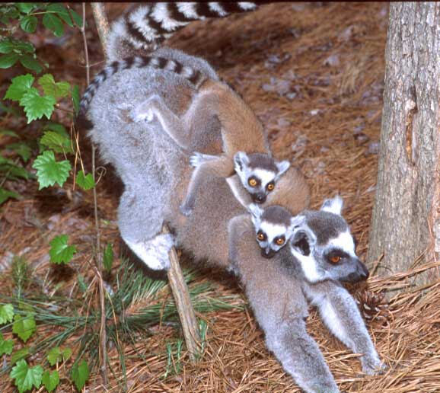
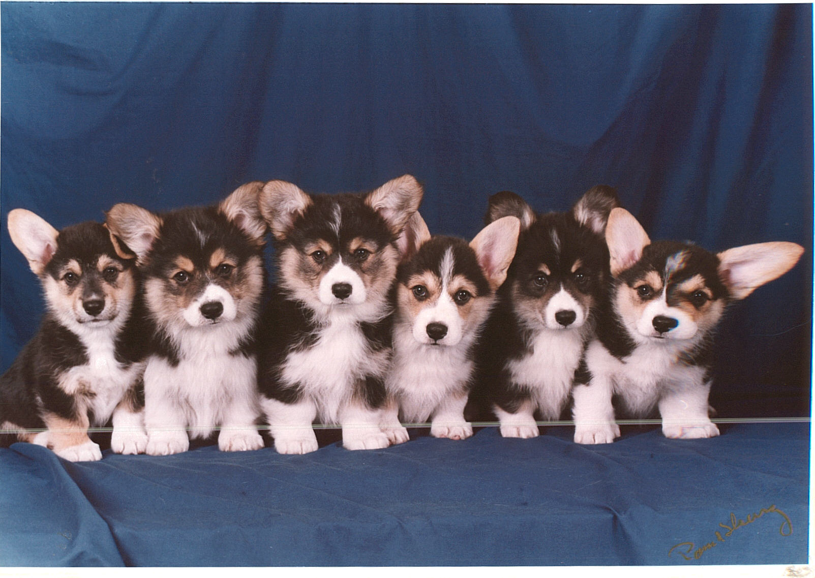
Reproduction

Slide 3
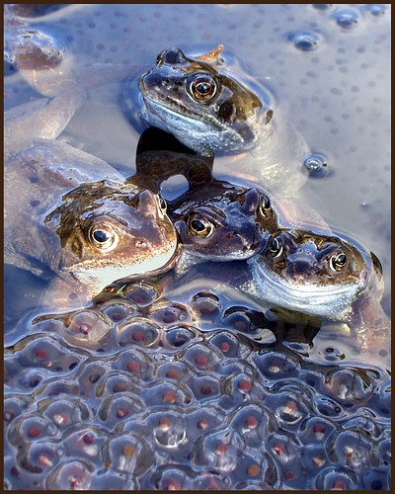
External fertilization
During external fertilization, many gametes are released into the water by each sex at the same time and place.
This type of fertilization requires water - animal sperm must swim to the eggs.
Water also protects the gametes from drying out.
Species which have external fertilization are either aquatic or return to water for reproduction
Ex. frogs and toads

Slide 4
Internal Fertilization
done through copulation, which involves the process on intercourse.
The sperm and the egg fuse inside the body of the organism.
Seen in more advanced organisms where the copulatory organs are well defined.
Ex. Humans, crocodiles (reptiles)

Slide 5
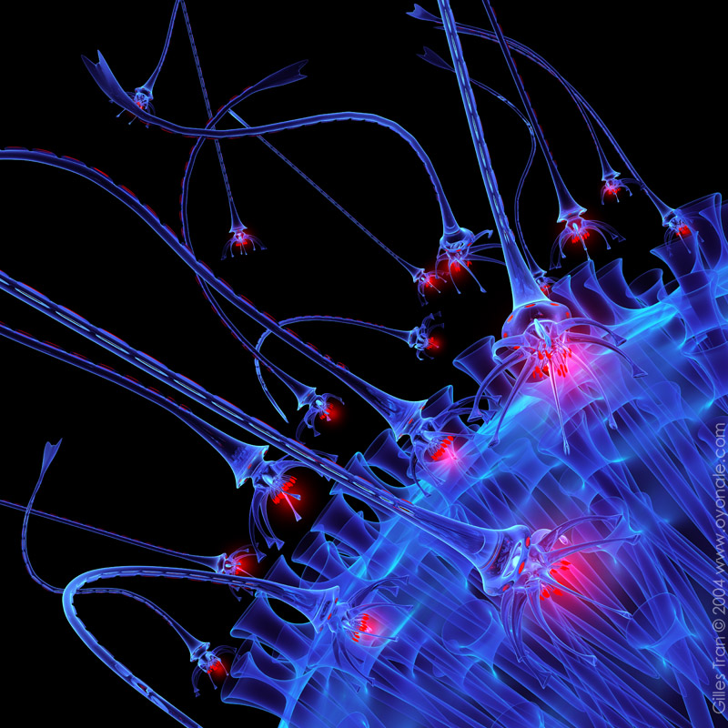
Reproduction in humans

Slide 6
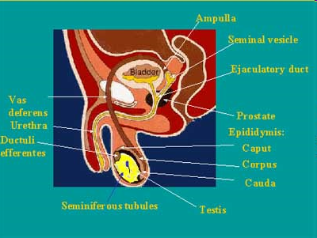
The Male Reproductive system

Slide 7
functions of male reproductive system
The organs of the male reproductive system are specialized for the following functions:
To produce, maintain and transport sperm (the male reproductive cells) and protective fluid (semen)
To discharge sperm within the female reproductive tract
To produce and secrete male sex hormones
The male reproductive anatomy includes internal and external structures.

Slide 8
External parts of the reproductive system
Penis
Scrotum
Semen
Testicles
Epididmysis

Slide 9
Penis — The penis is the male organ for sexual intercourse. The body of the penis is made up of special, sponge-like erectile tissue.
Semen, with the sperm, is expelled (ejaculated) through the end of the penis. When the penis is erect, the flow of urine is blocked from the urethra, allowing only semen to be ejaculated
are the body's main source of male hormones, such as testosterone

Slide 10
External parts: reproductive sys.
Scrotum — The scrotum is the loose pouch-like sac of skin that hangs behind the penis. It contains the testicles (also called testes), as well as many nerves and blood vessels. The scrotum has a protective function and acts as a climate control system for the testes. For normal sperm development, the testes must be at a temperature slightly cooler than the body temperature
Testis-The male sex glands- located behind the penis in a pouch of skin called the scrotum.
produce and store sperm

Slide 11
Internal parts of the reproductive system
Vas deferens — The vas deferens is a long, muscular tube that travels from the epididymis into the pelvic cavity, to just behind the bladder. The vas deferens transports mature sperm to the urethra in preparation for ejaculation.
Ejaculatory ducts — These are formed by the fusion of the vas deferens and the seminal vesicles. The ejaculatory ducts empty into the urethra.
Urethra — The urethra is the tube that carries urine from the bladder to outside of the body. In males, it has the additional function of expelling (ejaculating) semen when the man reaches orgasm. When the penis is erect during sex, the flow of urine is blocked from the urethra, allowing only semen to be ejaculated at orgasm.

Slide 12
Seminal vesicles — The seminal vesicles are sac-like pouches that attach to the vas deferens near the base of the bladder. The seminal vesicles produce a sugar-rich fluid (fructose) that provides sperm with a source of energy and helps with the sperms’ motility (ability to move). The fluid of the seminal vesicles makes up most of the volume of a man’s ejaculatory fluid, or ejaculate.
Prostate gland — The prostate gland is a walnut-sized structure that is located below the urinary bladder in front of the rectum. The prostate gland contributes additional fluid to the ejaculate. Prostate fluids also help to nourish the sperm..

Slide 13
How does the male reproductive function
the entire male reproductive system is dependent on hormones, which are chemicals that stimulate or regulate the activity of cells or organs.
The primary hormone involved in the functioning of the male reproductive system is the main hormone testosterone.
Testosterone also is important in the development of male characteristics, including muscle mass and strength, fat distribution, bone mass and sex drive.

Slide 14
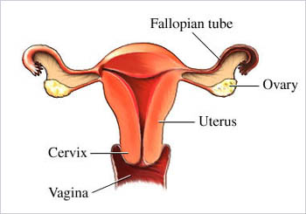
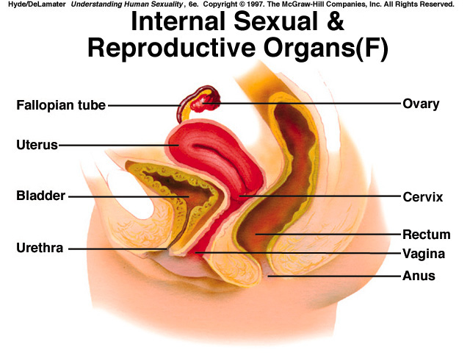
The Female Reproductive System

Slide 15
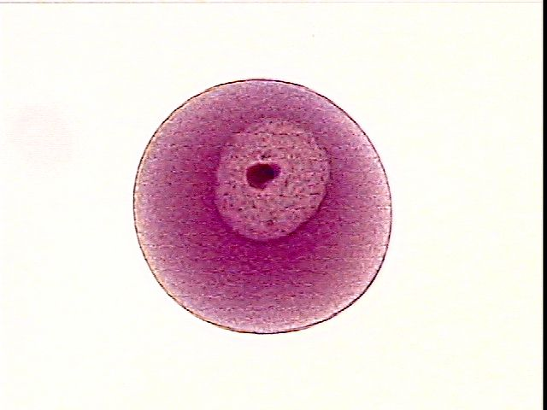
Ovaries-homologous with the testes in the male
organ inside the female body where ova or eggs are produced
main source of female hormones (estrogen and progesterone). These hormones control the development of female body characteristics
Egg cell /ovum- haploid female reproductive cell or gamete
Fallopian tubes- two very fine tubes leading from the ovaries into the uterus.

Slide 16
Uterus- hollow, pear-shaped organ located in a woman's lower abdomen
expands during pregnancy to hold the growing fetus and contracts during labour to deliver the child .
Cervix- the lower, narrow part of the uterus
forms a canal that opens into the vagina, which leads to the outside of the body

Slide 17
Vagina- muscular tubular tract leading from the uterus to the exterior of the body
It receives the male penis during sexual intercourse.
provides the passageway for menstrual blood during menstruation
the birth canal through which the baby is delivered

Slide 18
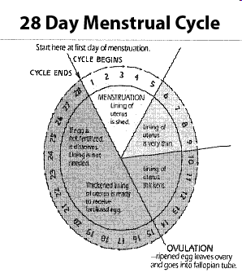
Menstruation

Slide 19
menarche
What is menstruation?
Menstruation is a normal body function that happens about once a month. It is the shedding of blood and tissue from your uterus. This menstrual fluid comes out of your body through the vagina
What is the menstrual cycle?
It is a series of changes taking place in the female reproductive organs leading up to the menstrual flow. An organ called the uterus or womb prepares a lining where a tiny female egg cell is not fertilized, pregnancy does not take place and the lining of the uterus is shed.

Slide 20
menarche
How does it all happen?
The average menstrual cycle is about 28 days. Your cycle length is the number of days from the first day of one period (counting that day as one) to the day before your next period starts
Why does your period sometimes come late or skip a month?
Until your organs adjust to your new cycle, your period may not come regularly. Also, it can be affected by your emotions or changes in routine like going to camp, taking a plane, or preparing for a test. If your period continues to be irregular, see a doctor.

Slide 21
menarche
At what age does menstruation stop?
Menstruation usually comes to an end during the mid-forties or early fifties. This is called menopause, or change of life. This process is similar to the changes you experience during adolescence when the reproductive organs begin to work. Menopause simply means the end of the reproductive years of a woman’s life and is a normal change. Now that you have the facts, you’ll be better able to understand what is happening to you. Menstruation is a natural part of life. Treat it that way and you won’t be embarrassed or upset each time it comes.

Slide 22
Hormonal control of Menarche
Pituitary hormone: FSH and LH
FSH: development of oocyte in the follicle
Thickening of follicle wall
Secretion of follicular fluid
Secretion of estrogen by follicle wall

Slide 23
LH: completion of meiosis by the oocyte
Partial digestion of the follicle wall allowing it to burst open(ovulation)
Growth of the corpus luteum which secretes estrogen and progesterone

Slide 24
Estrogen: thickening of the endometrium
Blood vessel growth in the endometrium
Increase in FSH receptors in the follicle
Inhibition of FSH secretion and stimulation of LH secretion when estrogen levels are high
Progesterone: It helps in maintaining thickened endometrium with many blood vessels
Inhibition of FSH and LH secretion.

Slide 25
Sexual intercourse
Sexual intercourse, also known as copulation or coitus, commonly refers to the act in which the male reproductive organ enters the female reproductive tract.
This is the process which leads to fertilization

Slide 26
Fertilization
The act or process of initiating biological reproduction by insemination or pollination. The union of male and female reproductive cells (gametes) to produce a fertilized reproductive cell (zygote).
Fusion of a sperm cell with an egg cell to produce a zygote when the female sex cell (egg) and the male sex cell (sperm) come in contact. the joining of a sperm and an egg The fusion of the male sex cell with the female sex cell to form an embryo is called fertilisation.

Slide 27
Fertilization
The sperms swim through the cervix and into the uterus by wriggling movements of their tails.
The sperms released through ejaculation are millions however a few hundreds may reach the fallopian tubes.
The released ovum stays in the fallopian tubes for 24 hours after which it perishes
The sperms may stay for 3-4 days which is the fertility period

Slide 28
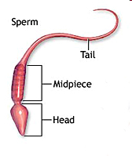
Sperm

Slide 29
Fertilization
Sperm swim in and are nourished in the semen. Once inside the fallopian tubes they have a life span of about 4-5 days.
This means they can be in the fallopian tube for 4-5 days in advance of ovulation and still fertilize the egg. The egg, unfertilized, has a life span of only about 24 hours.

Slide 30
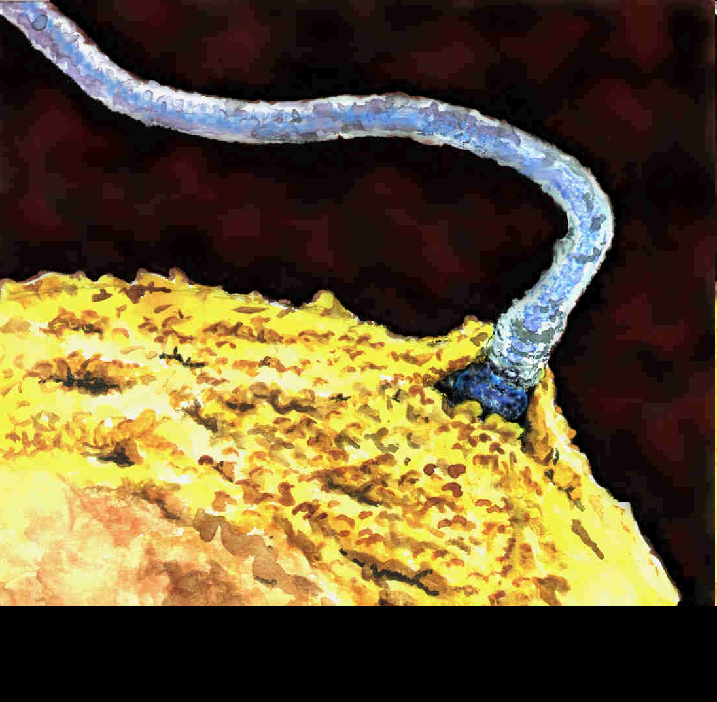

Slide 31
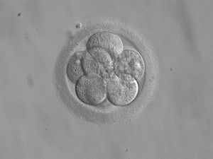
A blastula

Slide 32
Zygote
Fertilization is the process by which the nucleus of a sperm (a male reproductive cell) fuses (combines) with the nucleus of an egg (a female reproductive cell; also called an ovum).
A fertilized egg cell is known as a zygote. Once formed, the zygote undergoes continuous cell division that eventually produces a new multicellular organism

Slide 33
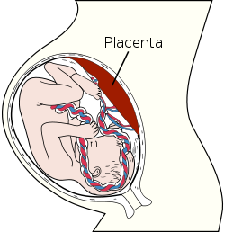
Placenta

Slide 34
Placenta
The placenta is an organ that connects the developing fetus to the uterine wall to allow nutrient uptake, waste elimination, and gas exchange via the mother's blood supply
The placenta a is attached to the lining of the uterus and is attached to the embryo with the help of umbilical cord

Slide 35
Role of placenta
A few weeks after the conception the fetal heart is developed which pumps blood through the placenta and the cord.
The placenta is the barrier between the mother and the growing fetus. It can select what substances can enter the and leave through the umbilical vein. It gives protection to the growing fetus against fluctuations in mothers B.P
However, some substances like alcohol and drugs can enter the placental barrier.
The placenta secretes human chorionic gonadotropin hormone

Slide 36
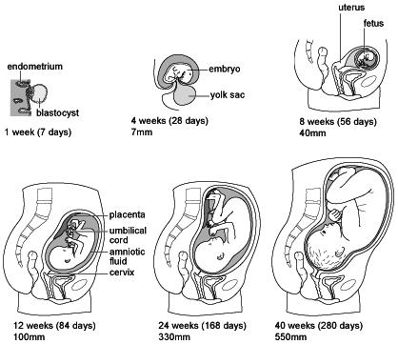
Different stages of pregnancy

Slide 37
Pregnancy and development
Gestation period: The complete time the fetus takes from fertilization till birth
34- 36 weeks or 9 months for the human fetus
The fetus is surrounded by amniotic fluid and amniotic sac. This protects the fetus from knocks and bumps.

Slide 38
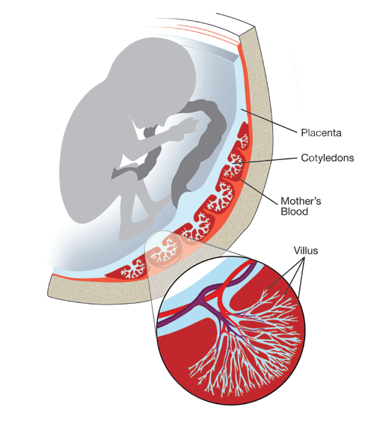
Role of placenta villi

Slide 39
The placental villi are finger like projections which provide a large, thin surface for exchange of materials between mother and fetus
Artery from the mother delivers blood which is -high in nutrients and oxygen
-Low in carbon dioxide and urea
The vein from the mother takes away blood which is
Low in nutrients
High in carbon dioxide and urea

Slide 40
Umbilical cord consists of umbilical artery
Carries deoxygenated blood containing wastes such as urea away from fetus
Umbilical vein carries oxygenated blood cleared of wastes from placenta to fetus. Blood contains a high concentration of soluble foods such as glucose amino acids and iron.
A countercurrent system

Slide 41
Child birth
Dilation
Expulsion
Placenta
Induced birth

Slide 42
Feeding and parental care
Prolactin
Oxytocin
Colostrum
Weaning
topfood

Slide 43
Extra embryonic membranes
Amnion is the membrane that covers the embryo.
Chorion is the membrane that covers the amnion, the yolk sac and the allantois.
The space delimited by the chorion and the amnion is called amniotic cavity and it is filled with aminiotic fluid.
The amniotic cavity has the functions of preventing desiccation of the embryo and of protecting it against mechanical shocks

Slide 44
IVF
In vitro fertilisation (IVF) is a process by which egg cells are fertilised by sperm outside the body, in vitro. IVF is a major treatment in infertility when other methods of assisted reproductive technology have failed. The process involves hormonally controlling the ovulatory process, removing ova (eggs) from the woman's ovaries and letting sperm fertilise them in a fluid medium.

Slide 45
Artificial insemination
Artificial insemination, or AI, is the process by which sperm is placed into the reproductive tract of a female for the purpose of impregnating the female by using means other than sexual intercourse
In humans, it is used as assisted reproductive technology, using either sperm from the woman's male partner or sperm from a sperm donor (donor sperm) in cases where the male partner produces no sperm or the woman has no male partner

Slide 46
Contraceptive methods
Natural
Contraception
Pill
Spermicides
IUD
The contraceptive pills
Sterilization

Slide 47
Sexually transmitted diseases
A sexually transmitted disease (STD), also known as sexually transmitted infection (STI) or venereal disease (VD), is an illness that has a significant probability of transmission between humans by means of human sexual behavior
Gonorrhea
HIV

Slide 48
Gonorrhea is a common sexually transmitted infectioncaused by the bacterium Neisseriag onorrhoeae. In the US, its incidence is secondonly to chlamydia among bacterial STDs. In both men and women if gonorrhea is left untreated, it may spread throughout the body, affecting joints and even heart valves.
Gonorrhea cannot be spread by sharing toilets and bathrooms

Slide 49
In males, symptoms include a yellowish discharge from the penis, associated with painful, and sometimes frequent, urination. Symptoms can develop from two to thirty days after infection. A few percent of infected men have no symptoms. The infection may move into the prostate, seminal vesicles, and epididymis, causing pain and fever. Untreated, gonorrhea can lead to sterility

Slide 50
More than half of women with gonorrhea show no symptoms, or symptoms mild enough to be ignored. Women may complain of vaginal discharge, difficulty urinating (dysuria), projectile urination, off-cycle menstrual bleeding, or bleeding after sexual intercourse. The cervix may appear anywhere from normal to the extreme of marked cervical inflammation with pus. Early symptoms may include a discharge from the vagina, discomfort in the lower abdomen, irritation of the genitals, pain or burning during urination and abnormal bleeding

Slide 51
HIV : SYMPTOMS
Rapid weight loss
Dry cough
Recurring fever or profuse night sweats
Profound and unexplained fatigue
Wollen lymph glands in the armpits, groin, or neck
Diarrhea that lasts for more than a week
White spots or unusual blemishes on the tongue, in the mouth, or in the throat
Pneumonia
Red, brown, pink, or purplish blotches on or under the skin or inside the mouth, nose, or eyelids
Memory loss, depression, and other neurological disorders

Slide 52
The major difference between HIV and AIDS is that the former ia virus, and the latter is a fatal disease. The presence of the retrovirus, HIV leads to the collapse of the immune system of the human body eventually leading to AIDS.
A retrovirus is a type of virus that affects the human immunity system. HIV or Human Immuno Deficiency viruses are lentivirus, which are a subset of retrovirus. Lentivirus causes very slow degeneration of the immunity system. A lentivirus is a subset of retro virus. It remains dormant for several days after it predates the human body.
The difference between HIV and AIDS is that, AIDS is a disease that occurs because of existence of HIV virus in the human body. The final stage of the HIV infection is called AIDS. . HIV is Human Immuno Virus. It is the name of the virus. While, AIDS is, Acquired Immuno Defficiency syndrome
, which is the disease

Slide 53
Growth and development
Growth
Development

