Slide 1
Osmoregulation
Controlling the Internal Environment

Slide 2
terms
Hypertonic: exo-smosis
Hypotonic: endosmosis
These have led to structural adaptations and physiological adaptations in order to maintain the balance of water and solutes.
Excretion : expulsion of waste products of metabolism. Ex urea, uric acid ammonia

Slide 3
Functions of excretory system
Toxins and other substances that are ingested and absorbed but are not fully metabolized Ex: betain, certain drugs
Excess water, produced by cell respiration and absorbed from food in the gut
Excess salt absorbed from food in the gur
Nitrogenous wasted Ex urea

Slide 4
Functions of Excretory System
Regulate body fluids
Volume, pH, composition
Remove metabolic wastes from blood
Control rate of RBC formation
Regulate blood pressure
Regulate absorption of calcium

Slide 5
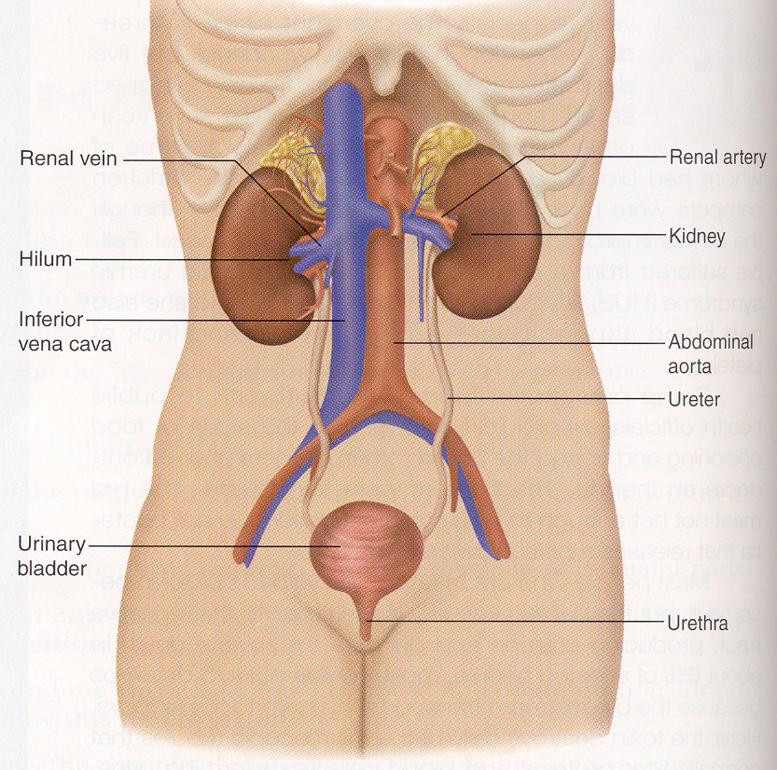
Gross Anatomy

Slide 6
Retroperitoneal Location

Slide 7
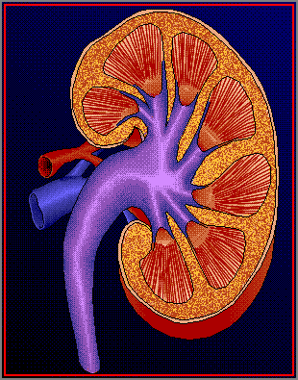
The structure of Kidney
Pyramid
Papilla
Cortex
Medulla
Hilum
Column
Calyx
Pelvis
Ureter

Slide 8
Structure of kidney
The kidney has a bean-shaped structure, each kidney has concave and convex surfaces. The concave surface, the renal hilum, is the point at which the renal artery enters the organ, and the renal vein and ureter leave. The kidney is surrounded by tough fibrous tissue, the renal capsule

Slide 9
The kidney is approximately 11–14 cm in length, 6 cm wide and 4 cm thick.
The substance, or parenchyma of the kidney is divided into two major structures
: superficial is the renal cortex and deep is the renal medulla
Grossly, these structures take the shape of 8 to 18 cone-shaped renal lobes, each containing renal cortex surrounding a portion of medulla called a renal pyramid (of Malpighi)

Slide 10
Between the renal pyramids are projections of cortex called renal columns (of Bertin).Nephrons, the urine-producing functional structures of the kidney, span the cortex and medulla.
The initial filtering portion of a nephron is the renal corpuscle located in the cortex, which is followed by a renal tubule that passes from the cortex deep into the medullary pyramids.
Part of the renal cortex, a medullary ray is a collection of renal tubules that drain into a single collecting duct
The tip, or papilla, of each pyramid empties urine into a minor calyx, minor calyces empty into major calyces and major calyces empty into the renal pelvis which becomes the ureter.

Slide 11
Blood supply
The kidneys receive blood from the renal arteries, left and right, which branch directly from the abdominal aorta. Despite their relatively small size, the kidneys receive approximately 20% of the cardiac output

Slide 12
Kidney : structure
Innervation
The kidney and nervous system communicate via the renal plexus, whose fibers course along the renal arteries to reach the kidney. Input from the sympathetic nervous system triggers vasoconstriction in the kidney, thereby reducing renal blood flow

Slide 13
Functions
Acid-base homeostasis
Acid-base homeostasis
Two organ systems, the kidneys and lungs, maintain acid-base homeostasis, which is the maintenance of pH around a relatively stable value. The kidneys contribute to acid-base homeostasis by regulating bicarbonate (HCO₃⁻) concentration.

Slide 14
Osmolality regulation
Any significant rise in plasma osmolality is detected by the hypothalamus which communicates directly with the posterior pituitary gland. An increase in osmolality causes the gland to secrete antidiuretic hormone (ADH), resulting in water reabsorption by the kidney and an increase in urine concentration. The two factors work together to return the plasma osmolality to its normal levels.

Slide 15
ADH binds to principal cells in the collecting duct that translocate aquaporins to the membrane allowing water to leave the normally impermeable membrane and be reabsorbed into the body by the vasa recta, thus increasing the plasma volume of the body

Slide 16
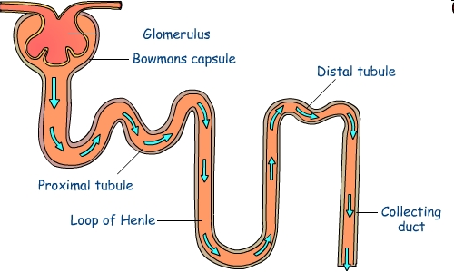
Ultra structure of Nephron
PCT
Bowman’s
capsule
DCT
Vasa recti
Glomerulus
Ascending
tubule
Descending
Tubule
Collecting duct

Slide 17
Structure of Nephron
Bowmans capsule- Bowman’s capsule: Blood is filtered under high pressure (ultrafiltration). Wastes plus some useful molecules plus some water are filtered into the nephron
Glomerulus
Filtration of blood
Water
Electrolytes
Glucose
Urea.

Slide 18
Function of Renal Corpuscle
Proximal convoluted tubule: useful molecules plus most of water are selectively reabsorbed into the blood
Loop of Henle: alters salt concentration in the medulla to aid re-absorption of water from the collecting ducts

Slide 19
Formation of urine
Collecting duct: kidney can reabsorb water from here and return it to the blood according to the body’s demands under the influence of anti diuretic hormone
Urine containing wastes dissolved in a small volume of water

Slide 20
urea
The urea forms the major constituent of urine. It is formed from the de-amination of amino acids. The urea formation takes place in the liver.

Slide 21
Formation of urine
Urine is produced in the kidneys from water and wastes extracted from the blood
Blood is supplied to the kidneys by the renal arteries which branch off the aorta. The kidneys and are drained by the the renal veins into the inferior vena cava

Slide 22
Function of Tubules
Reabsorption of glucose
Proximal convoluted tubule
Reabsorption of water
PCT, descending tubule, collecting duct
Reabsorption of salts
PCT, ascending tubule, distal con. tub.
Reabsorption of urea
PCT, collecting duct

Slide 23
Selective absorption
In selective reabsorption glucose, amino acids and glucose are reabsorbed from the filtrate back into the blood
In the collecting duct kidney can reabsorb water and return to the blood according to the body’s needs.

Slide 24
Ultrafiltration (UF) is a variety of membrane filtration in which hydrostatic pressure forces a liquid against a semi permeable membrane. Suspended solids and solutes of high molecular weight are retained, while water and low molecular weight solutes pass through the membrane.

Slide 25
In biological terms, ultra filtration occurs at the barrier between the blood and the filtrate in the renal corpuscle or Bowman's capsule in the kidneys. The Bowman's capsule contains a dense capillary network called the glomerulus. Blood flows into these capillaries through a wide afferent arteriole and leaves through a narrower efferent arteriole. The blood pressure inside these capillaries is high because

Slide 26
The renal artery contains blood at very high pressure which enters the glomerulus via the short afferent arteriole.
The efferent arteriole has a smaller diameter than the afferent arteriole.
The high pressure forces small molecules such as water, glucose, amino acids sodium chloride and urea through the filter, from the blood in the glomerular capsule across the basement membrane of the Bowman's capsule and into the nephron. This type of high pressure filtration is ultra filtration. The fluid formed in this way is called glomerular filtrate

Slide 27
Glomerular pressure is about 75 millimeters of mercury (10 kPa). It is opposed by osmotic pressure(30 mmHg, 4.0 kPa) and hydrostatic pressure (20 mmHg, 2.7 kPa) of solutes present in capsular space. This difference in pressure is called effective pressure(25 mmHg)(3.3 kPa).

Slide 28
Glomerular filtration rate
Glomerular filtration rate (GFR) is the volume of fluid filtered from the renal glomerular capillaries into the Bowman's capsule per unit time..
Glomerular filtration rate (GFR) can be calculated by measuring any chemical that has a steady level in the blood, and is freely filtered but neither reabsorbed nor secreted by the kidneys.
The rate therefore measured is the quantity of the substance in the urine that originated from a calculable volume of blood. The GFR is typically recorded in units of volume per time, e.g. milliliters per minute ml/mi. Compare to filtration fraction
There are several different techniques used to calculate or estimate the glomerular filtration rate (GFR or eGFR).

Slide 30
Osmoregulation
The water content of the body can vary depending on various factors. Hot weather and physical activity such as exercise make us sweat and so lose body fluids.
Drinking tends to be at irregular intervals when socially convenient. This means that sometimes the body has too little water and needs to conserve it and sometimes too much water and needs to get rid of it. Most of the control of water conservation takes place in the distal and collecting tubules of the nephrons under control of anti-diuretic hormone, (ADH), sometimes called vasopressin.
This hormone is released by the posterior pituitary under control of the hypothalamus in the mid-brain area. The hypothalamus monitors the water content of the blood. If the blood contains too little water (indicating dehydration) then more ADH is released. If the blood contains too much water (indicating over-hydration) then less ADH is released into the blood stream

Slide 31
dehydration
Athletes who want to loose weight can take drugs to interfere with ADH. Less water is reabsorbed, more is lost in the urine and the body looses weight
HANGOVER- Alcohol reduces the effect of kidney. Water is reabsorbed and the body becomes dehydrated. Dehydrated brain cells cause a headache.

Slide 32
dialysis
A dialysis machine is artificial kidney.
It takes the patient’s blood and ‘ cleans’ it.
Wastes diffuse out of the blood across a partially permeable membrane into a fluid that is constantly renewed. In this way urea is removed from the blood

Slide 33
A dialysis machine

Slide 34
A dialysis machine
Blood is taken from artery leaves body under pressure.
Blood returns to the body through vein (since blood in vein is at low pressure)
Chamber removes blood clots and re-warms blood to body temperature so body is not shocked when blood returns.
Dialysis fluid has a compostion which means that urea and salts diffuse into it from the blood but useful solutes and water do not.
Diffusion of urea out of blood is aided by countercurrent flow of plasma and dialysis fluid- they flow in opposite directions maintaining the concentration gradient.

