Slide 1
Gas exchange

Slide 2
Distinguish between ventilation, gas exchange and cell respiration.
Gaseous Exchange: is the exchange of gases between the organism and its surroundings, including the uptake of Oxygen and the release of Carbon dioxide in animals and plants.
Ventilation: is a pumping mechanism that moves air into and out of lungs efficiently, thereby maintaining the concentration gradient for diffusion.
Cellular Respiration: is the controlled release of energy in the form of ATP from organic compounds in cells.

Slide 3
Explain the need for a ventilation system.
A ventilation system is needed to maintain concentration gradients in the alveoli
The steep concentration gradient across the respiratory surface is maintained in two ways:
by blood flow on one side and by air flow on the other side. The ventilation system replaces diffused oxygen (keeping the concentration high) and removes carbon dioxide (keeping the concentration low).
This means oxygen can always diffuse down its concentration gradient from the air to the blood, while at the same time carbon dioxide can diffuse down its concentration gradient from the blood to the air.

Slide 4
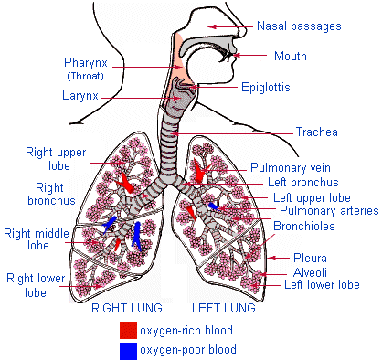

Slide 5
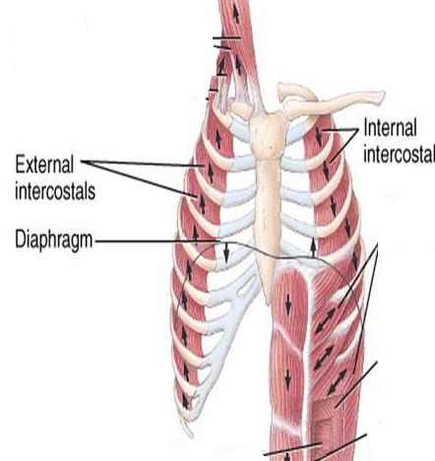
Intercostal muscle

Slide 6
the mechanism of ventilation
Inspiration (Breathing in is an active process)
The external intercostal muscles contract and the internal intercostals relax.
This pulls the rib cage up and outwards.
At the same time the Diaphragm muscles contract.
This flattens the diaphragm
Both actions increase the volume of the thorax
As a result the pressure in the thorax, and hence the lungs is reduced to less than atmospheric pressure.
Air enters the lungs, inflating alveoli, until the air pressure in the lungs is equal to that of the atmosphere.

Slide 7
expiration
Expiration (Breathing out is largely a passive process)
The external intercostal muscles relax and the internal intercostals contract.
The rib cage drops, mainly due to its own weight.
At the same time the Diaphragm muscles relax.
The dropping rib cage forces the diaphragm into a domed shape, pushing it up into the thoracic cavity
These events reduce the volume of the thorax and raise its pressure above that of the atmosphere.
Consequently air is forced out of the lungs.

Slide 8
Lung volume and capacity
Adult female = 4 dm³ Adult Male = 5 dm³
Tidal Volume: volume of gas exchanged during one breath in & out. It is about 450 cm³ during normal breathing and about 3 dm³ during forced breathing.
Inspiratory reserve volume: continuation of inspiration after normal inhalation an extra 1500 cm³ of air can be inhaled.
Expiratory reserve volume: continuation of expiration after normal exhale an extra 1500 cm³ of air can be inhaled.
Vital Capacity: Maximum volume of air that can be exchanged during one breath in & out (forced inspiration & expiration) = 5.7 dm³ for a male and 4.25 dm³ for female.
Residual volume: Even after forced expiration 1500 cm³ of air remain in the lungs. This cannot be expelled.

Slide 9
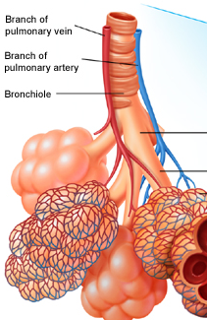
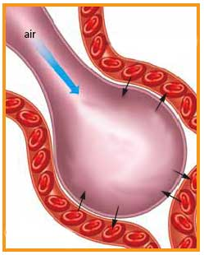
the features of alveoli that adapt them to gas exchange.

Slide 10
alveoli
Alveoli have elastic connective tissue as an integral part of their walls.
A capillary system wraps around the cluster of alveoli.
Each capillary is connected to a branch of the Pulmonary artery and is drained by a branch of Pulmonary Vein.

Slide 11
the features of alveoli that adapt them to gas exchange.
There are 700 million alveoli in our lungs, providing a surface area of approximately 70 m^{2.}
The wall of an alveolus is one cell thick, made of flattened epithelial cells, lying very close to capillary.
Moist surface for the dissolution of gases.
Short diffusion distance from alveoli to blood (0.5-1.0 um).
The capillaries are extremely narrow, just wide enough for the Erythrocytes to squeeze through, so that they are in close contact with capillary wall.

