Slide 1
Evolution
Gradual development of life in geological cycle

Slide 2
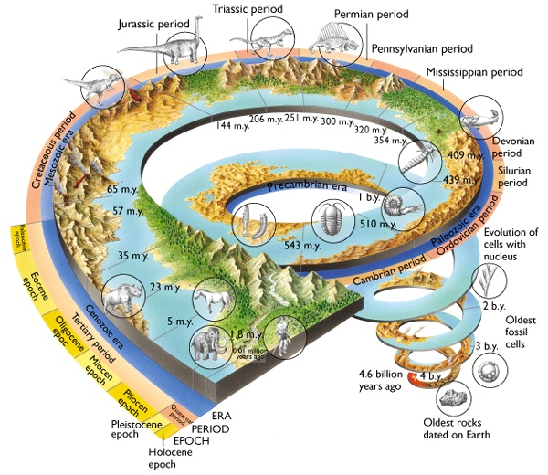
Geological Cycle

Slide 3
natural selection leads to evolution.
overproduction of offspring leads to struggle for survival.
variation exists within species.
some varieties better adapted than others.
best adapted survive / reproduce and pass on characteristics.
evolution is change in species / allele frequency with time;

Slide 4
Definition
Evolution is the process of cumulative change in the heritable characteristics of population

Slide 5
Antibiotic resistance in bacteria
Environmental changes (e.g. application of antibiotics) affects some varieties more than others.
best adapted survive to reach reproductive age and breed to pass on alleles.
The result is alleles found in best adapted / become more frequent in population.
This is referred to as natural selection, which results in change in species with time / change in allele frequency.
This is termed evolution.

Slide 6
Pepper moth
Check this site for natural selection of pepper moth.
http://www.techapps.net/interactives/pepperMoths.swf

Slide 7
sexual reproduction promotes variation in a species
Meiosis:
crossing over / chiasma formation in prophase I
Random orientation / Independent assortment of homologues at metaphase I;
fertilization by chance / one of many male gametes
number of different gametes is 2n genes / alleles combined from two parents;

