Slide 1
Digestion
why digestion of large food
molecules is essential?

Slide 2
The need for enzymes in digestion.
Biological process are very slow.
Enzymes accelerate the process.
Body temperature for enzymes.

Slide 3
State the source, substrate, products and optimum pH conditions for one amylase, one protease and one lipase.

Slide 4
Draw and label a diagram of the digestive system.
The diagram should show the mouth, esophagus, stomach, small intestine, large intestine, anus, liver, pancreas and gall bladder.
The diagram should clearly show the interconnections between these structures.

Slide 5
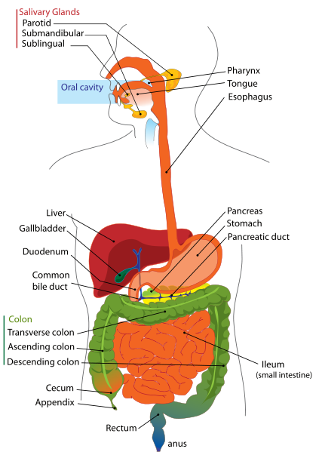

Slide 6
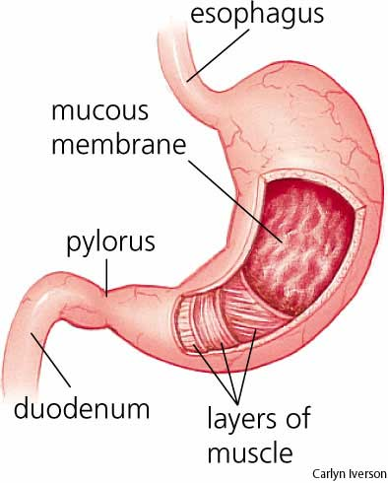
Outline the function of the stomach

Slide 7
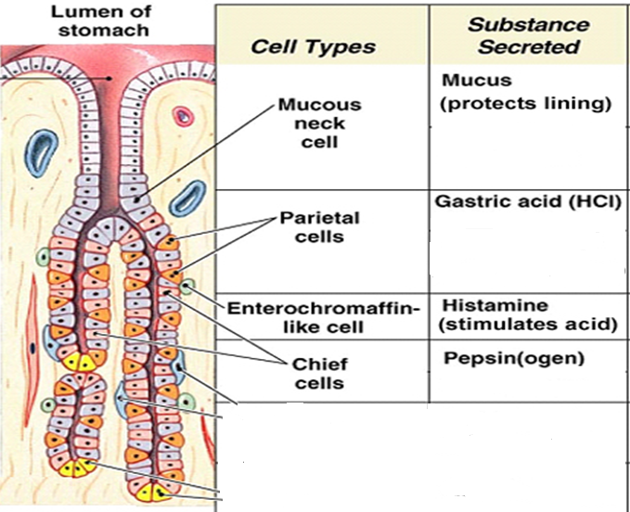
Gastric Pits

Slide 8
Small Intestine
Approximately 3 mts long and 2.5 Cms in dia.
Divided into three parts
duodenum
jejunum
Ileum

Slide 9
Small Intestine
The Mucosa (outermost layer of the SI) is folded into many finger like projections called Villi.
Villi & microvilli provides a large surface area (>600 folds) App 300 m x m.

Slide 10
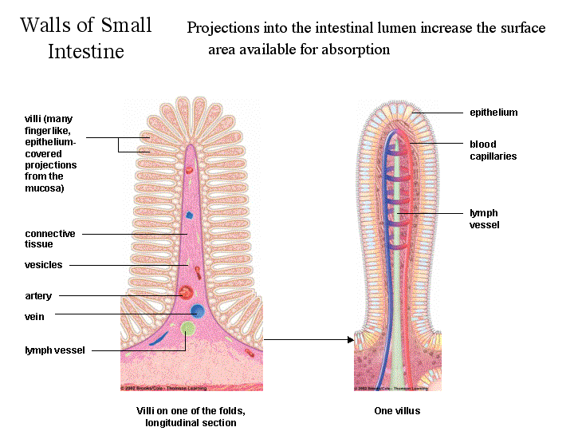
Villi

Slide 11
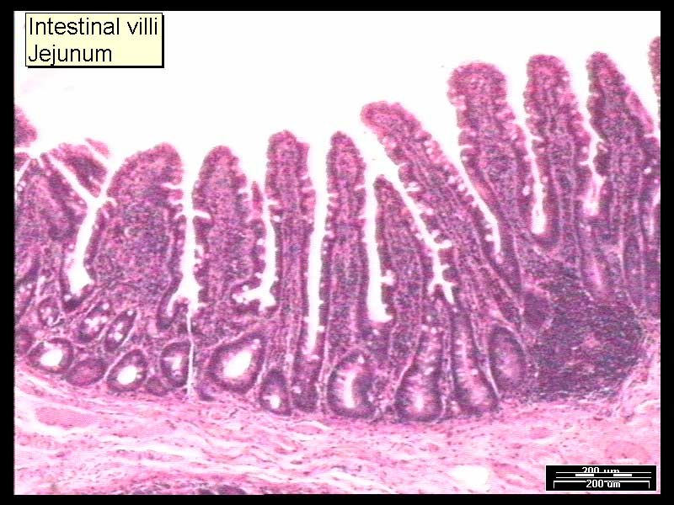

Slide 12
Small Intestine
Cells in the crypt secret intestinal juice , a slightly alkaline fluid, which helps to neutralise the acid.
Paneth cells secret Lysozyme, an
antibacterial enzyme.
Goblet cells secret mucus

Slide 13
Digestion in the duodenum
Bile secreted by liver and stored in the Gall bladder.
Contains a mixture of salts (Sodium Glycocholate )
Salts reduce the surface tension of fat globules and emulsify then into droplets, providing large surface area for the lipase to act.

Slide 14
Digestion in the duodenum
Pancreatic juice contains bicarbonate ions to neutralize acid chyme.
Pancreatic amylase
Converts starch to Maltose
Trypsinogen
Converted to trypsin by enterokinase, digests proteins into smaller polypeptide chains and more trypsinogen into trypsin.

Slide 15
Digestion in the duodenum
Chymotrypsin converts Proteins directly into amino acids.
Carboxypeptidase converts polypeptides into amino acids.
Lipase converts lipids to fatty acids & Glycerol.

Slide 16
Absorption of Food in the SI
Most of the nutrients are absorbed in the ileum.
Villi is supplied with rich network of blood capillaries & lymphatics.
Disaccharides are broken down into Monosaccharides by the enzymes present on the surface of villus.

Slide 17
Absorption of Food in the SI
Monosaccharides , amino acids and dipeptides are absorbed initially by facilitated diffusion and later by Active Transport (ATP required).
Small proteins are also absorbed by endocytosis & exocytosis.
Finally transported into the blood capillaries.

Slide 18
Absorption of Fat in the SI
Fatty acids and glycerol diffuse into the epithelial cells of the villi.
Reconverted to lipids in the ER of these cells.
Proteins present in the cells coat lipids to form lipoproteins droplets, called chylomicrons.
Chylomicrons pass out of the epithelial cells by exocytosis into lacteals.

Slide 19
Large Intestine
No digestion takes place in the LI.
About 90% of the fluid and salts are reabsorbed into the blood stream.
Some inorganic substances, notably calcium and Iron in excess are excreted in the LI.
Goblet cells secret mucus to facilitate lubrication of the solidifying undigested food (Faeces).

Slide 20
Large Intestine
Symbiotic bacteria present in the LI synthesize amino acids and Vitamin K, which are absorbed into the bloodstream.
The bulk of faeces consists of bacteria, cellulose, dead epithelial cells, mucus, cholesterol, bile pigments and water.
Can remain in the colon for 36 hours before being egested.

Slide 21
Anus
Two sphincters surround the anus.
Internal one made of smooth muscle under the control of autonomic nervous system (involuntary)
Outer one made of striated muscle controlled by the voluntary nervous system.

Slide 22
Assignment
Distinguish between absorption and assimilation.

