Slide 1
Defence against infectious disease
Pathogen: An organism or virus that causes disease. Most, but not all, are microorganisms.

Slide 2
external Barriers against infection
Skin
Mucus
Stomach Acid
Acidic Lining in the vagina

Slide 3
Leukocytes
There are thousands of different types of Leukocytes each with a specific job in defending the body against disease. They form part of the immune system.
When a disease is detected the corresponding Leukocyte cell is copied until there are millions produced which attack the invading foreign cell.

Slide 4
Different types of Leukocytes
Phagocytes
Macrophages
Monocytes
Neutrophils
Basophils
Eosinophils
Natural Killer cells
Lymphocytes
B Cells
Plasma Cells
Memory Cells
T Cells
T-C (Cytotoxic T cells)
T-H ( T Helper Cells)

Slide 5
Innate Immunity
Immunity that occurs naturally as a result of a person's genetic constitution or physiology and does not arise from a previous infection or vaccination.
Also called genetic immunity, inherent immunity, native immunity, natural immunity, nonspecific immunity.

Slide 6
Innate Immunity
Cells involved are Phagocytes (Macrophage)
Damaged cells release certain chemicals called Heat shock proteins.
Macrophages leave the capillaries and reach the site of infection.
Macrophage ingest the pathogen and digests it in a process called Phagocytosis
http://highered.mcgraw-hill.com/sites/0072495855/student_view0/chapter2/animation__phagocytosis.html

Slide 7
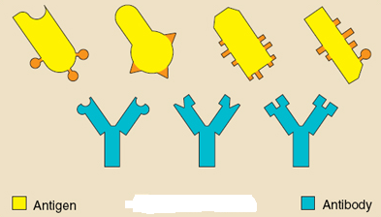
Antigen & antibody
Antigen
Antibody
Cell surface proteins present on the non self cells, that stimulates the adaptive immune system to produce specific antibodies.
An immunoglobulin, a specialized immune protein, produced because of the introduction of an antigen into the body, and which possesses the remarkable ability to combine with the very antigen that triggered its production.

Slide 8
Antibody Production
Different B cell Specific to one Antigen exists.
When the body encounters antigen specific B cell rapidly divides secreting antibodies.
Antibodies either neutralize the antigen or tag it for the macrophage to engulf it.

Slide 9
Human Immunodeficiency virus
HIV attacks T-H cells
T-H cells play a central role in antibody production.
They also regulate differentiation of T-C cells.
As a whole the Adaptive immune system will collapse.
http://highered.mcgraw-hill.com/olc/dl/120088/micro41.swf

Slide 10
Antibiotics against infection
Naturally occurring substance
Acts against bacteria
Disrupts the cell wall formations
Stops protein synthesis 70S ribosome.
Viruses don’t have their own metabolism. Instead they depend on host’s cells, so antibiotics are not effective against virus.
http://www.sumanasinc.com/scienceinfocus/antibiotics/antibiotics_fla.html

Slide 11
hiv
Discuss the cause, transmission and
social implications of AIDS.

Slide 12
Recognition of Self
Cell are identified by surface glycoprotein present on the plasma membrane called MHC Major Histocompatabality Complex.
Genes for MHC are present on chromosome 6 and inherited.
Sexual selection makes MHC individual specific
Antigen Receptors present on the lymphocytes can recognize our own MHC from foreign antigens.
http://outreach.mcb.harvard.edu/animations_S04.htm

Slide 13
Principle of challenge & response
B cells secrete antibodies (humoral response)
T cells assist B cells and may attack infected cells (cell-mediated response).
B & T cells develop immunocompetence , as they mature to recognize and bind to only one type of antigen.
They are stored in the lymph nodes

Slide 14
Clonal selection & polyclonal response
Selection of particular B cell for humoral response is clonal selection.
Pathogen may contain more than one antigen and may trigger clonal selection of more than one B cell.

Slide 15
Memory cells
During B cell proliferation after clonal selection few of the cells remain as memory cells.
Plasma cells are short lived.
Memory cells are stored in Lymph nodes.

Slide 16
Types of immunity
Passive Immunity: immunity due to
Acquisition of antibodies from the mother via placenta while in the uterus.
Through colostrum (first formed milk)
Through injection
Active Immunity: due to the production of antibodies by the organism, after the body’s defences have been exposed to antigens.

Slide 17
Antigen presentation
Antigen Presenting cells
Dendrite Cells
Macrophage
B Cells

Slide 18
Antibody production
http://highered.mcgraw-hill.com/olc/dl/120110/micro33.swf
http://outreach.mcb.harvard.edu/animations_S04.htm

Slide 19
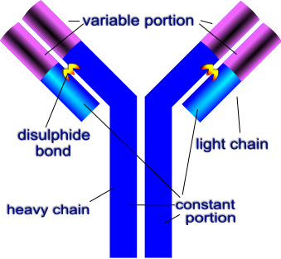
Antibody

Slide 20
Antibody
special protein called immunoglobulin.
Made of four polypeptide chains held together by disulphide bonds.
Different binding sites are made using shuffling of genes.
http://outreach.mcb.harvard.edu/animations_S04.htm

Slide 21
Monoclonal Antibody production
Murine B cell + Myeloma Cell = Hybridoma cells
http://highered.mcgraw-hill.com/sites/0072495855/student_view0/chapter2/animation__phagocytosis.html

Slide 22
Application of Monoclonal antibodies
Pregnancy test
http://www.whfreeman.com/kuby/con_index.htm?99anm

Slide 23
Cytotoxic T cell
http://highered.mcgraw-hill.com/olc/dl/120110/micro34.swf
http://outreach.mcb.harvard.edu/animations_S04.htm

